Slide 1

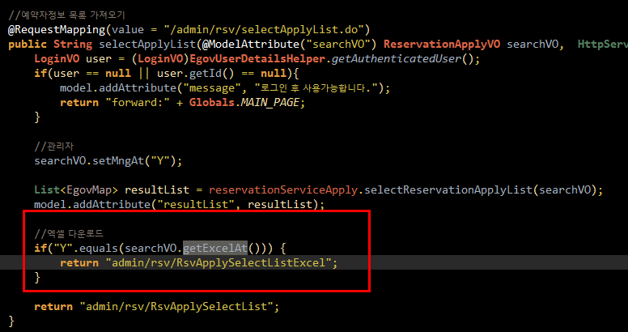
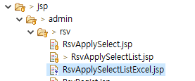
JSP방식
* ReservationApplyVO.java
* ReservationAdminApplyController.java

Slide 2
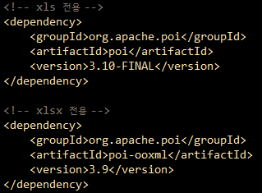
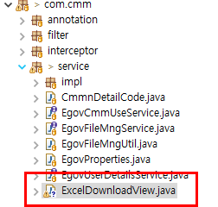
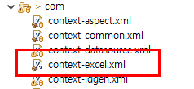
JAVA방식
* pom.xml
* 파일 생성

Slide 3
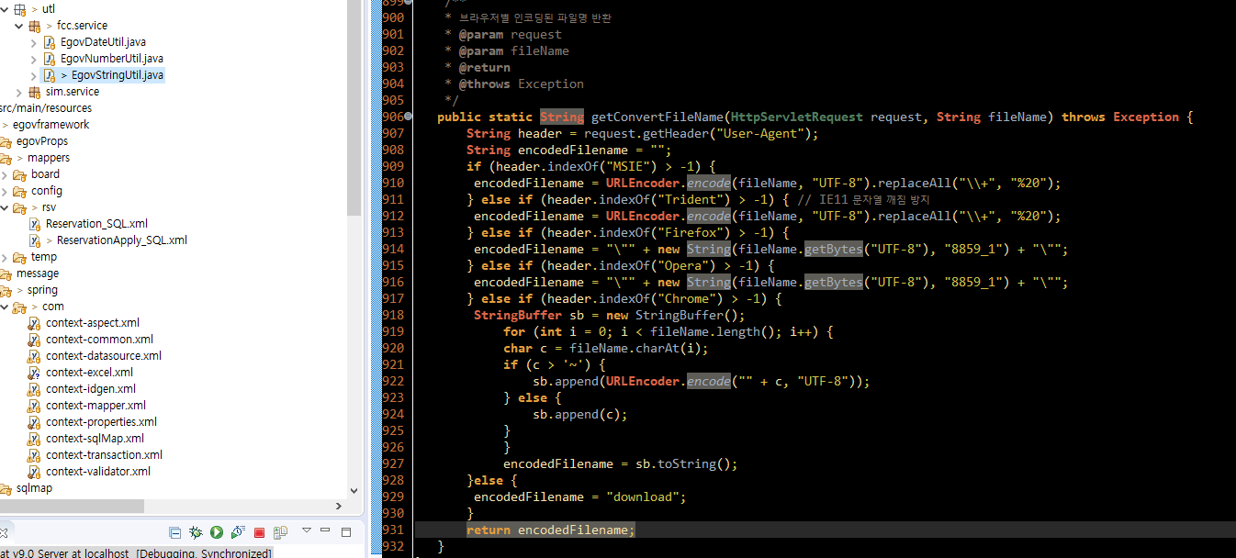
* 메소드 생성

Slide 4
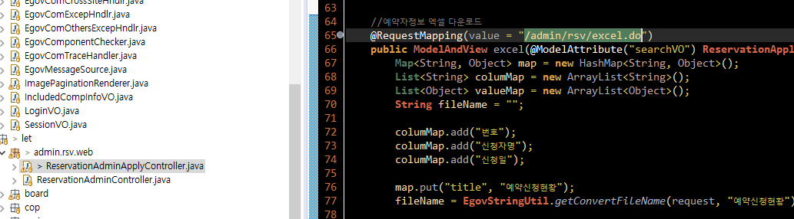
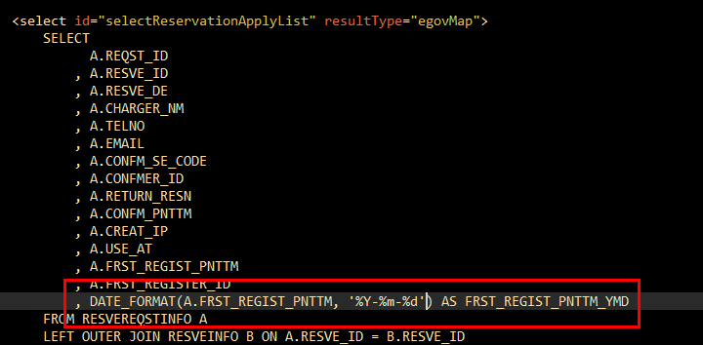

Slide 5
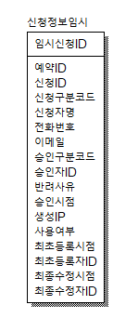
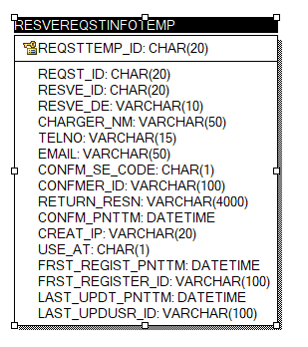
CREATE TABLE RESVEREQSTINFOTEMP
(
REQSTTEMP_ID CHAR(20) NOT NULL,
REQST_ID CHAR(20) NULL,
RESVE_ID CHAR(20) NULL,
RESVE_DE VARCHAR(10) NULL,
CHARGER_NM VARCHAR(50) NULL,
TELNO VARCHAR(15) NULL,
EMAIL VARCHAR(50) NULL,
CONFM_SE_CODE CHAR(1) NULL,
CONFMER_ID VARCHAR(100) NULL,
RETURN_RESN VARCHAR(4000) NULL,
CONFM_PNTTM DATETIME NULL,
CREAT_IP VARCHAR(20) NULL,
USE_AT CHAR(1) NULL,
FRST_REGIST_PNTTM DATETIME NULL,
FRST_REGISTER_ID VARCHAR(100) NULL,
LAST_UPDT_PNTTM DATETIME NULL,
LAST_UPDUSR_ID VARCHAR(100) NULL
);
ALTER TABLE RESVEREQSTINFOTEMP
ADD PRIMARY KEY (REQSTTEMP_ID);
ALTER TABLE RESVEREQSTINFOTEMP COMMENT = '신청정보임시';

Slide 6

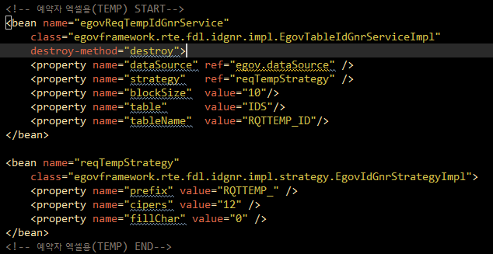
INSERT INTO ids(
TABLE_NAME
,NEXT_ID
) VALUES (
'RQTTEMP_ID'
,1
)
* ReservationApplyServiceImpl.java 추가
* context-idgen.xml

Slide 7
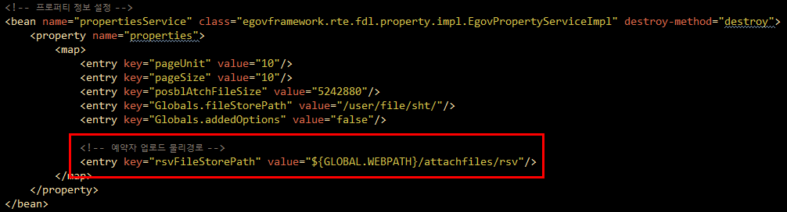

* globals.properties
* context-properties.xml

Slide 8
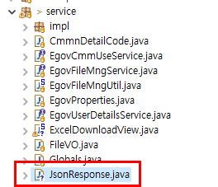
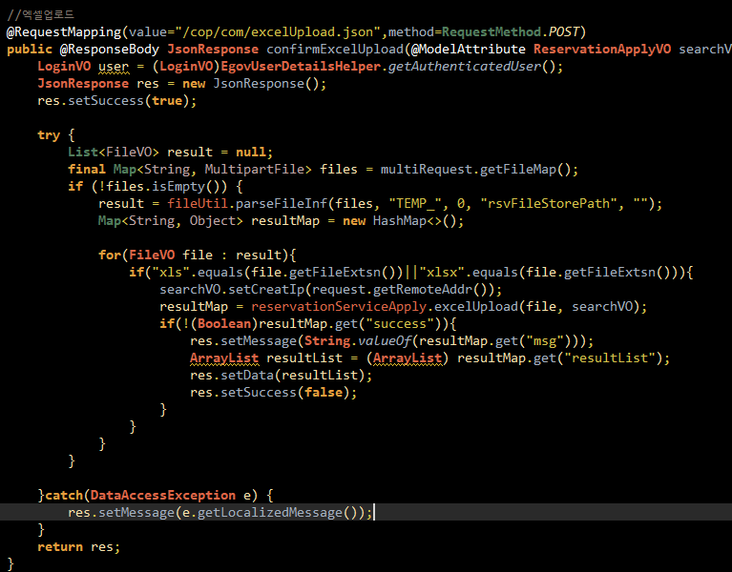
* JsonResponse.java 생성
* 엑셀업로드 생성

Slide 9



